Slide 1
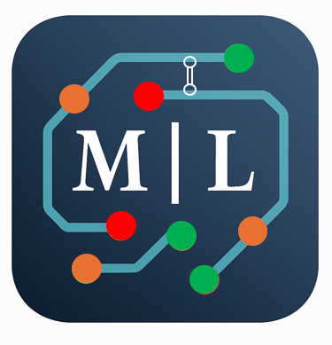
Marc Landy – Network Architect
Architecture; Digital Portfolio Beyond the Resume
Professional Background
▫ My experience demonstrates proven capabilities in enterprise network architecture as detailed by my attached resume link.
Architecture Philosophy & Approach → GitHub page: Network: At the Edge of Enablement
▫ It outlines my strategic approach to solution architecture and stakeholder engagement.
Solution Architecture Portfolio → medium.com
▫ Categorized case studies across, Network Architecture, Cross-Domain Governance,
and Infrastructure domains.
Capability Framework
▫ Interactive Dashboard → view of primary, secondary, & tertiary skills with,
business value mapping, one-page [PowerPoint view or download]
↳ summarizes key capabilities with quantified benefits.
Technical Implementation
GitHub Portfolio → Live projects demonstrating hands-on technical expertise.
Value Proposition:
▫ These resources showcase the strategic thinking and stakeholder communication skills that complement technical delivery, addressing the visibility challenge Enterprise Architects face in demonstrating business impact.

